Slide 1
Chapter 8
Network Management Security

Slide 2
Outline
Basic Concepts of SNMP
SNMPv1 Community Facility
SNMPv3
Recommended Reading and WEB Sites

Slide 3
Basic Concepts of SNMP
An integrated collection of tools for network monitoring and control.
  Single operator interface
  Minimal amount of separate equipment. Software and network communications capability built into the existing equipment
SNMP key elements:
  Management station
  Managament agent
  Management information base
  Network Management protocol
    Get, Set and Notify

Slide 4
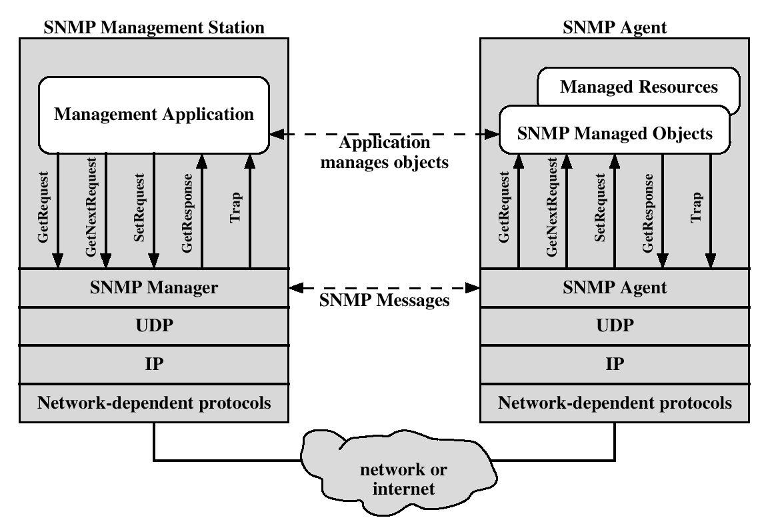
Protocol context of SNMP

Slide 5
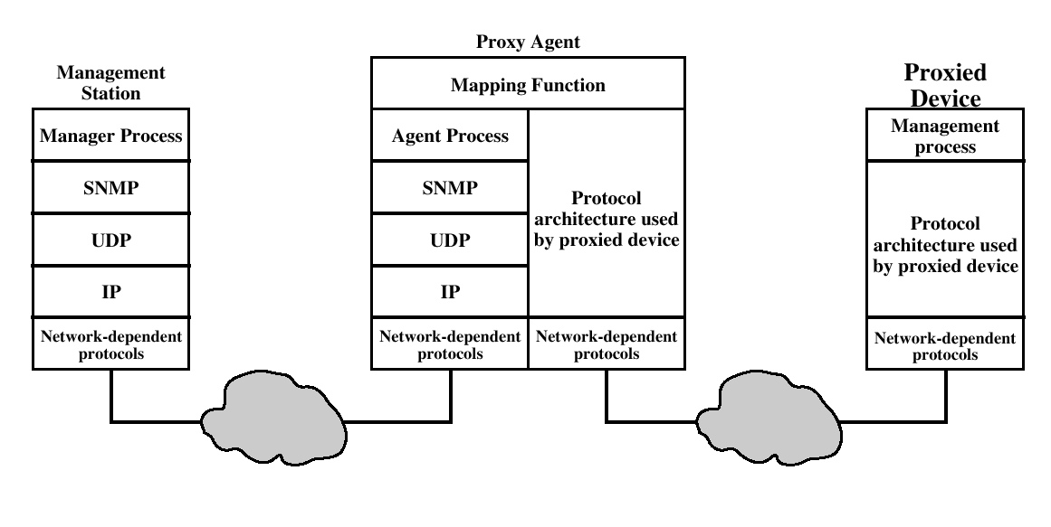
Proxy Configuration

Slide 6
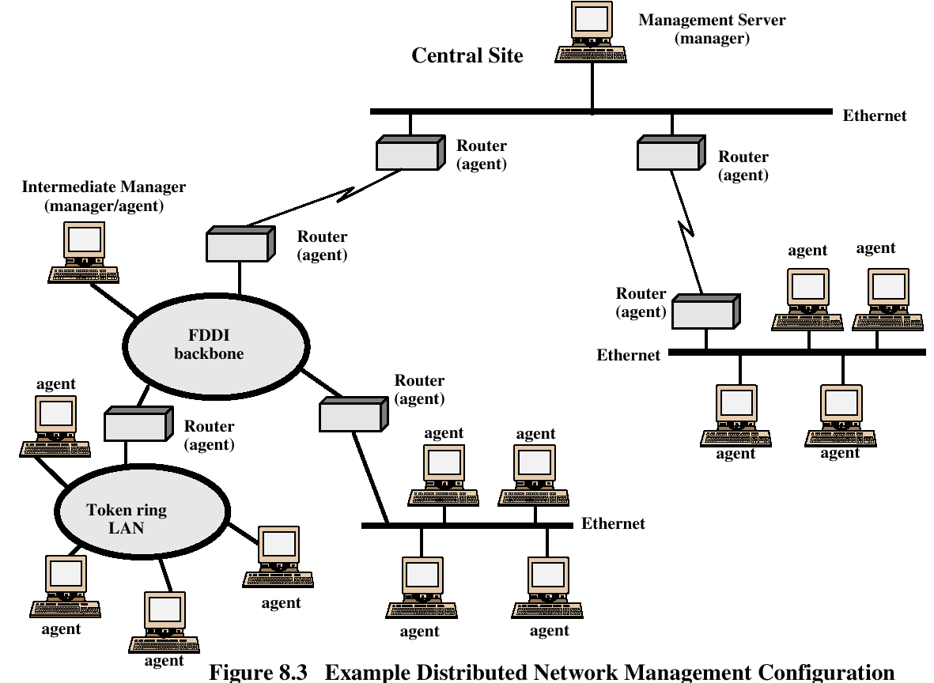

Slide 7
SNMP v1 and v2
Trap – an unsolicited message (reporting an alarm condition)
SNMPv1 is ”connectionless” since it utilizes UDP (rather than TCP) as the transport layer protocol.
SNMPv2 allows the use of TCP for ”reliable, connection-oriented” service.

Slide 8
Comparison of SNMPv1 and SNMPv2
SNMPv1 PDU | SNMPv2 PDU | Direction | Description
GetRequest | GetRequest | Manager to agent | Request value for each listed object
GetRequest | GetRequest | Manager to agent | Request next value for each listed object
------ | GetBulkRequest | Manager to agent | Request multiple values
SetRequest | SetRequest | Manager to agent | Set value for each listed object
------ | InformRequest | Manager to manager | Transmit unsolicited information
GetResponse | Response | Agent to manager or Manage to manager(SNMPv2) | Respond to manager request
Trap | SNMPv2-Trap | Agent to manager | Transmit unsolicited information

Slide 9
SNMPv1 Community Facility
SNMP Community – Relationship between an SNMP agent and SNMP managers.
Three aspect of agent control:
  Authentication service
  Access policy
  Proxy service

Slide 10
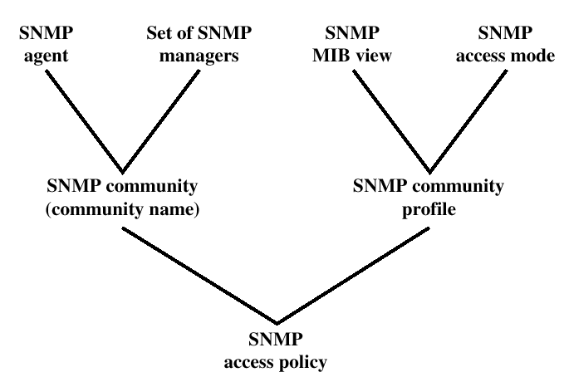
SNMPv1 Administrative Concepts

Slide 11
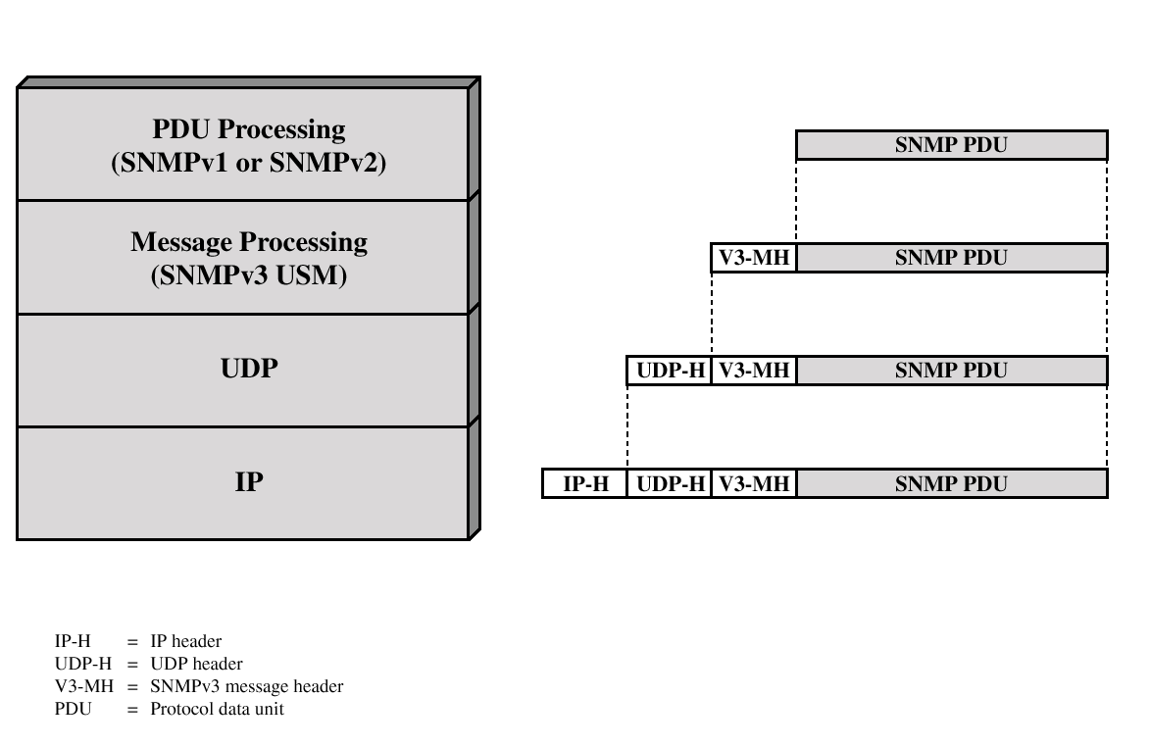
SNMPv3
SNMPv3 defines a security capability to be used in conjunction with SNMPv1 or v2

Slide 12
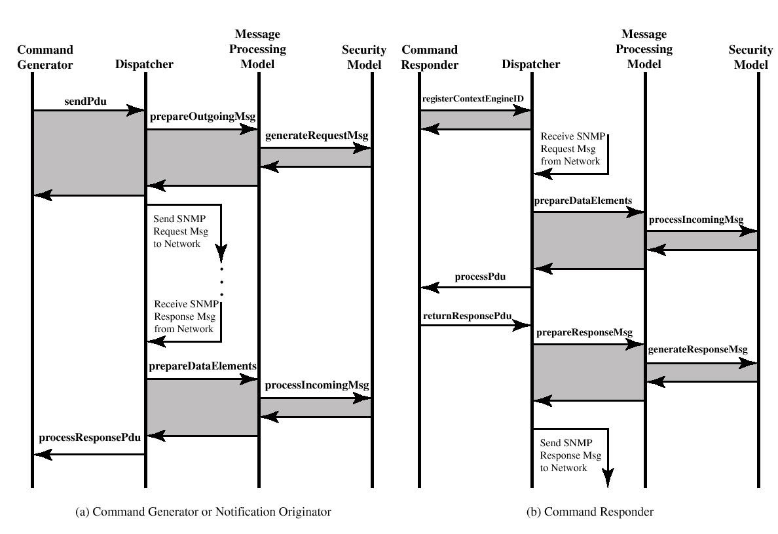
SNMPv3 Flow

Slide 13
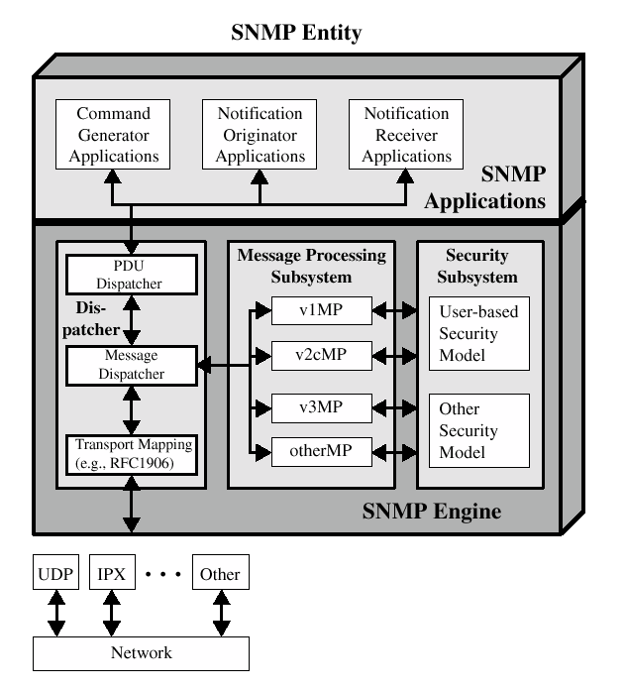
Traditional SNMP Manager

Slide 14
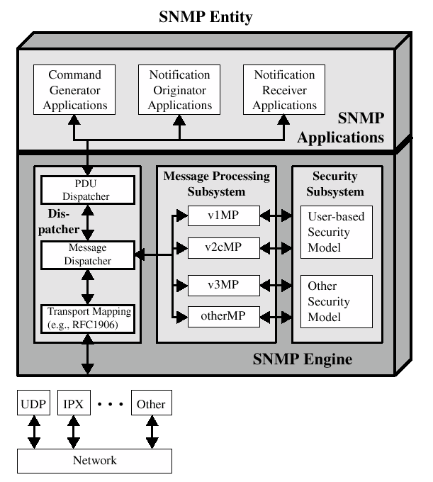
Traditional SNMP Agent

Slide 15
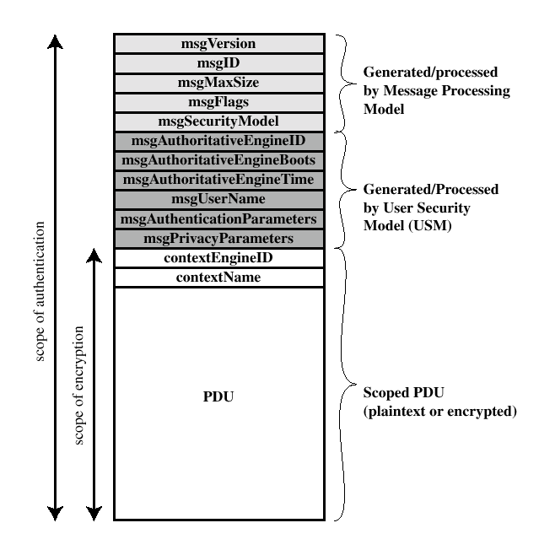
SNMP3 Message Format with USM

Slide 16
User Security Model (USM)
Designed to secure against:
  Modification of information
  Masquerade
  Message stream modification
  Disclosure
Not intended to secure against:
  Denial of Service (DoS attack)
  Traffic analysis

Slide 17
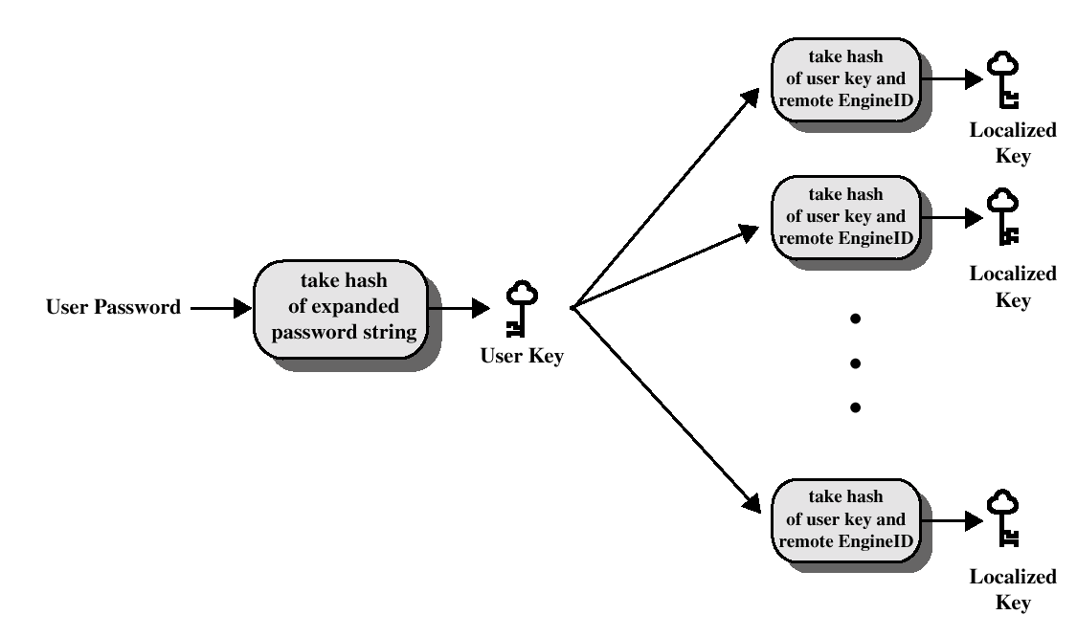
Key Localization Process

Slide 18
View-Based Access Control Model (VACM)
VACM has two characteristics:
  Determines wheter access to a managed object should be allowed.
  Make use of an MIB that:
    Defines the access control policy for this agent.
    Makes it possible for remote configuration to be used.

Slide 19
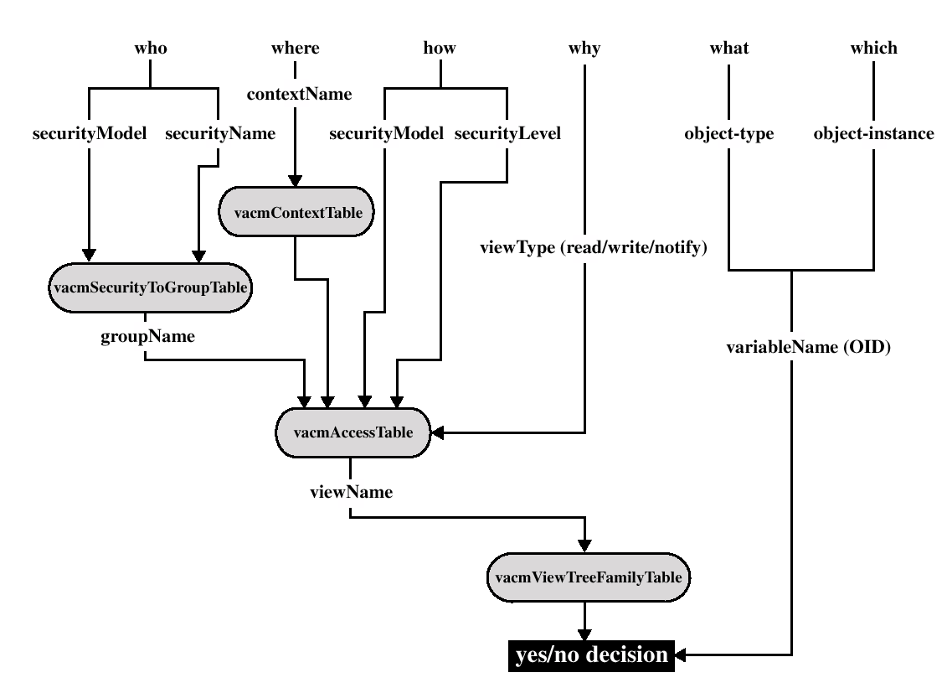
Access control decision

Slide 20
Recommended Reading and WEB Sites
Subramanian, Mani. Network Management. Addison-Wesley, 2000
Stallings, W. SNMP, SNMPv1, SNMPv3 and RMON 1 and 2. Addison-Wesley, 1999
IETF SNMPv3 working group (Web sites)
SNMPv3 Web sites

